Slide 1
ConfigMgr AMA
Your Questions, Expert Answers

Slide 2
Attention
MMS sessions are 60-75 minutes followed by LONG Q&A
Please hold detailed questions until that Q&A starts
Feel free to ask clarification questions
Remind the speakers to use Zoom It when you can’t see

Slide 3
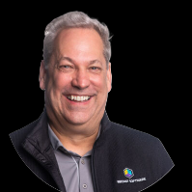
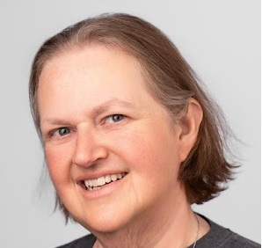


Matt Wreede
Sherry Kissinger
Garth Jones
Cardinal Health
Cardinal Health
Recast Software
@Hotdog453
@slkissinger

Slide 4
The First Section
With a little description here

Slide 5
How to win at life
According to Brian

